Slide 1
Sampling Theorem

Slide 2
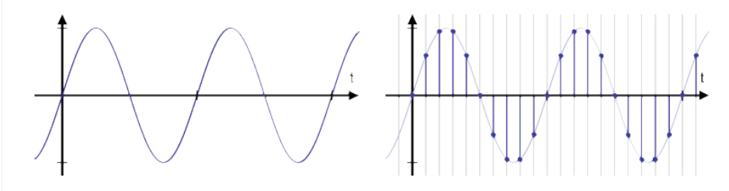
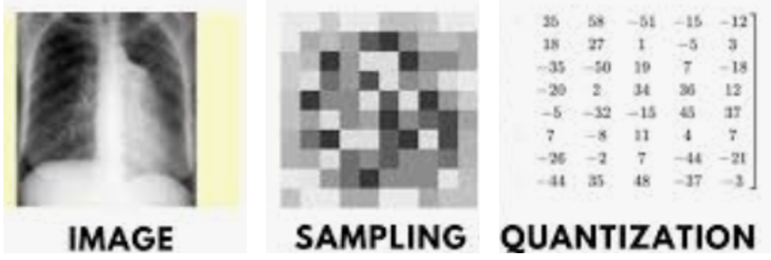
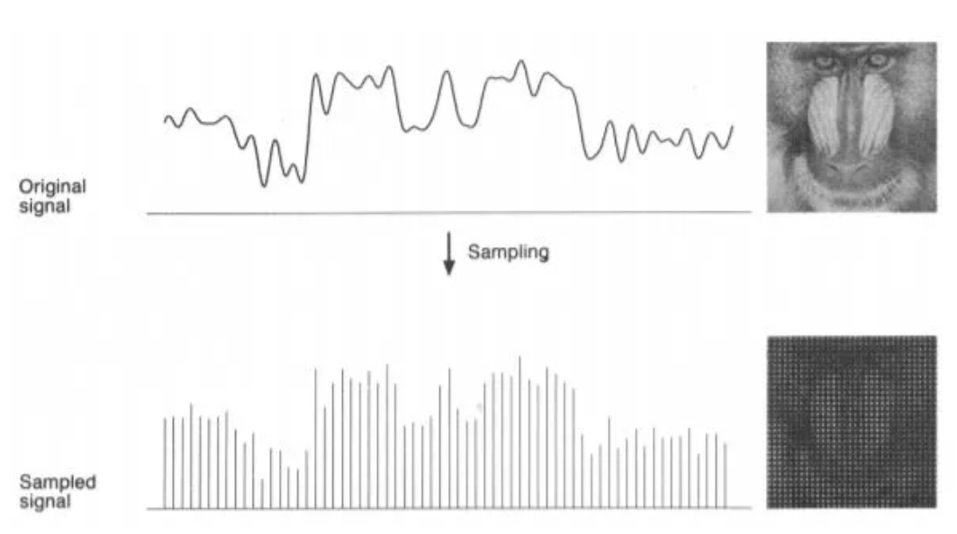
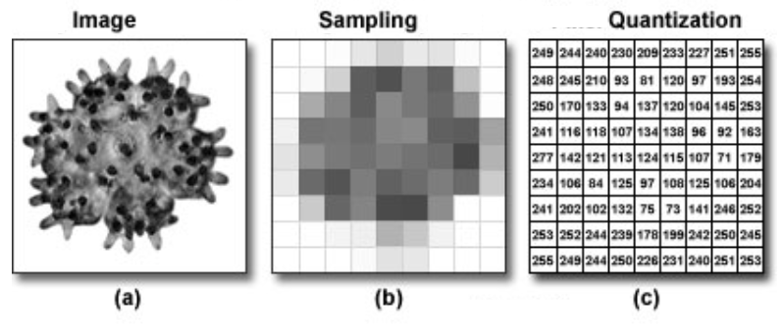
Sampling And Quantization
Sampling is the process of converting a continuous-time signal into a discrete-time signal.
Quantization is the process of mapping continuous infinite values to a smaller set of discrete finite values.
Quantization is a process to convert the continuous analog signal to the series of discrete values.

Slide 3
Sampling Rate Or Sampling Frequency
The sampling frequency (or sample rate) is the number of samples per second in a Signal.
The rate at which samples are taken by the oscilloscope is called the sample frequency, the number of samples per second
The sample rate is the number of samples taken per second to represent a continuous audio signal

Slide 4
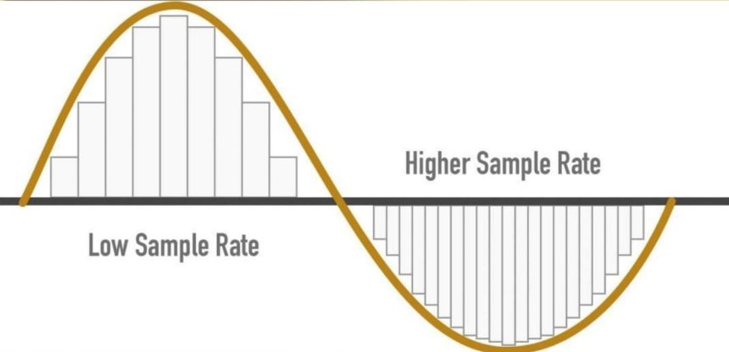
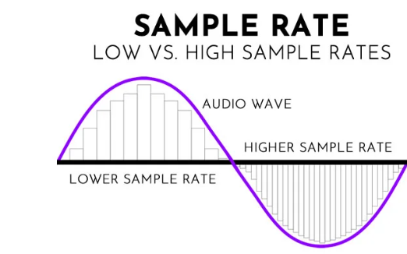

Slide 5
Sampling Rate And Bit Depth
Sample rate and bit depth are technical parameters in digital audio processing. The sample rate is the number of samples taken per second to represent a continuous audio signal, while the bit depth is the number of bits used to represent each sample’s amplitude. These parameters significantly impact the accuracy and quality of the digital audio output.
Understanding how these technical parameters work and how to optimize them can help you achieve high-fidelity sound reproduction and take your audio projects to the next level.

Slide 6
Sampling

Slide 7
Signal Digitization
Signal Digitization means converting an Analog Signal into a Digital Signal.
Operation Of Signal Digitization
this operation involves two processes: Sampling and Quantization
Signal Digitization
01Nov
There are popular digitization techniques such as: Pulse Code Modulation (PCM) and Delta Modulation (DM).This section describes sampling and quantization concepts and illustrates these two techniques.

Slide 8
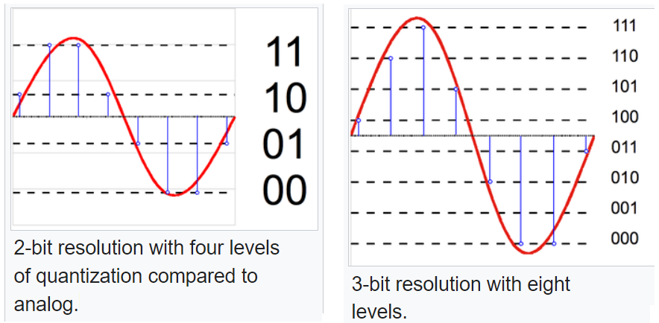
Quantization
Quantization is the process of mapping continuous infinite values to a smaller set of discrete finite values.
Quantization is a process to convert the continuous analog signal to the series of discrete values.

Slide 9
Quantization
Quantization is the process of mapping continuous infinite values to a smaller set of discrete finite values.
Quantization is a process to convert the continuous analog signal to the series of discrete values.
Quantization
Previous section talked about sampling and how sampling produces a sequence of numbers which can be any number from the continuous range,which means infinite values for each number. This section represents each number from the continuous range using finite numbers of digits this process is called quantization. There are two techniques used to digitize signals:Pulse Code Modulation (PCM) and Delta Modulation (DM). Pulse Code Modulation (PCM) PCM involves three processes or steps to digitize a signal: sampling, quantization, binary encoding. These processes are shown in the following figure. First,the analog signal sampled then, sampled signal quantized after that, quantized values are encoded as stream of bits.

Slide 10
Signal Digitization Techniques
Pulse Code Modulation (PCM)
Delta Modulation (DM)

Slide 11
Signal Digitization
Signal Digitizatio0n means converting an analog
Signal Digitization
01Nov
Signal digitization means converting an analog signal to a digital signal and this operation involves two processes: Sampling and Quantization. The main advantage of digitization is its resistance to distortion; it is much easier to reliably transmit a digital signal over a long distance than an analog signal. Also, digital signals can be easily stored without deterioration [4].There are many applications were digital signal processing is used such as:Radar and Sonar, Biomedical, Speech, Communications [4]. There are popular digitization techniques such as: Pulse Code Modulation (PCM) and Delta Modulation (DM).This section describes sampling and quantization concepts and illustrates these two techniques.

Slide 12
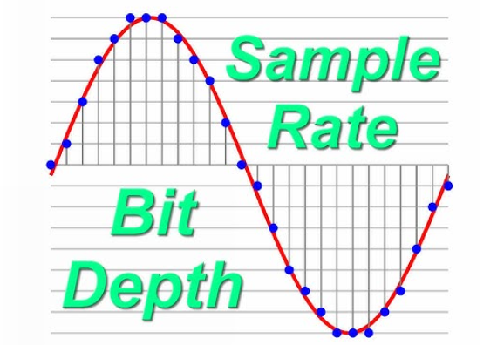
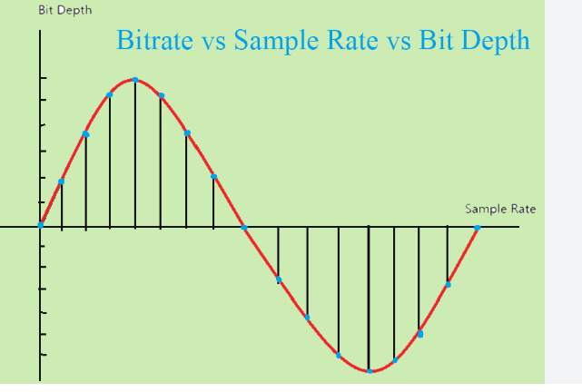
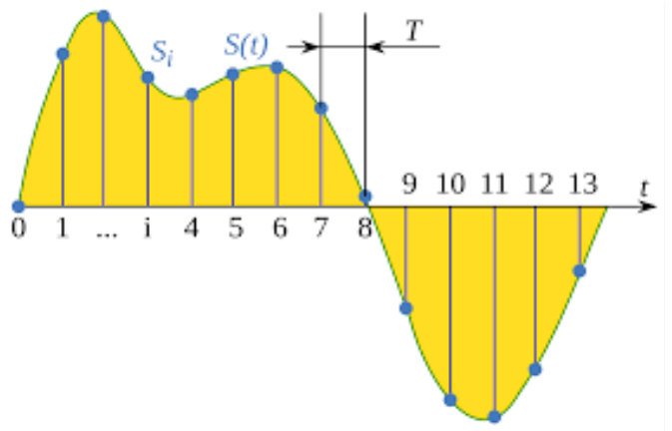
Sampling
Sampling is the process of converting an analog sample into discrete form.

Slide 13
Nyquist–Shannon sampling theorem

Slide 14
Aliasing
Original Frequency is mixed with Sampled Frequency is known as Aliasing.
Aliasing is the overlapping of frequency components resulting from a sample rate below the Nyquist rate.
This overlap results in distortion or artifacts when the signal is reconstructed from samples which causes the reconstructed signal to differ from the original continuous signal.

Slide 15
Avoiding Aliasing Effect
Aliasing is generally avoided by applying low-pass filters or anti-aliasing filters (AAF) to the input signal before sampling and when converting a signal from a higher to a lower sampling rate.
Suitable reconstruction filtering should then be used when restoring the sampled signal to the continuous domain or converting a signal from a lower to a higher sampling rate.
For spatial anti-aliasing, the types of anti-aliasing include fast approximate anti-aliasing (FXAA), multisample anti-aliasing, and supersampling.

Slide 16
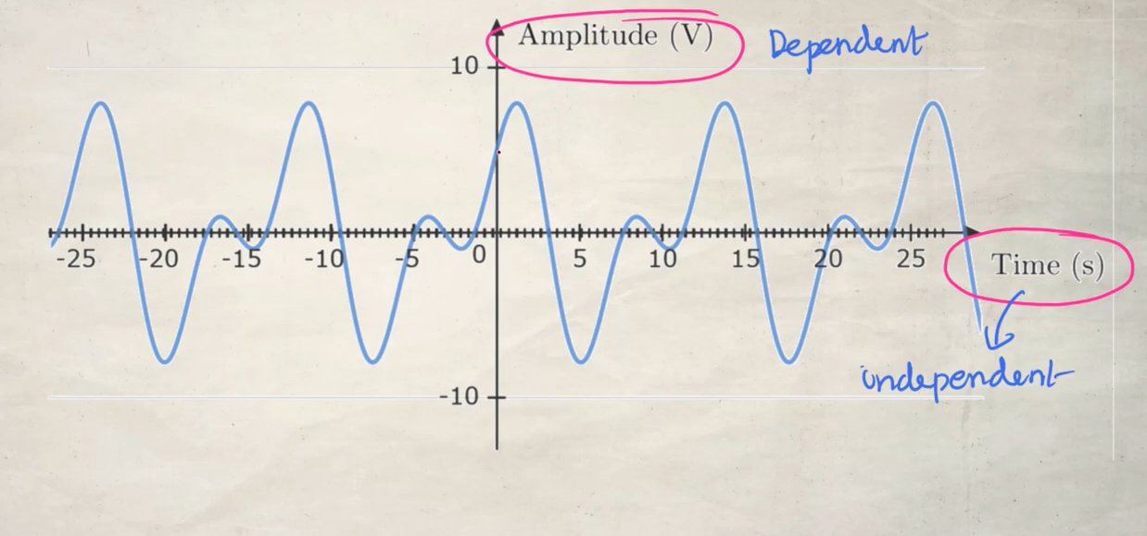
https://www.youtube.com/watch?v=iWHlv6kQ1Ag

Slide 17
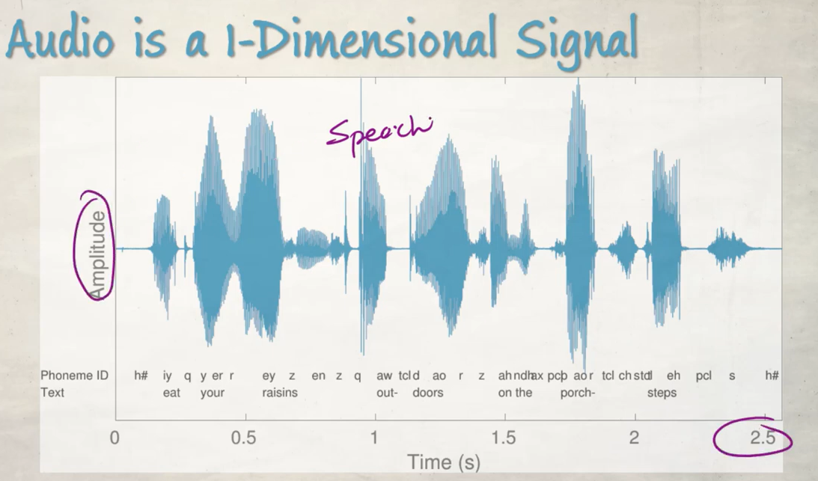
Signal having one dependent and one independent variable

Slide 18
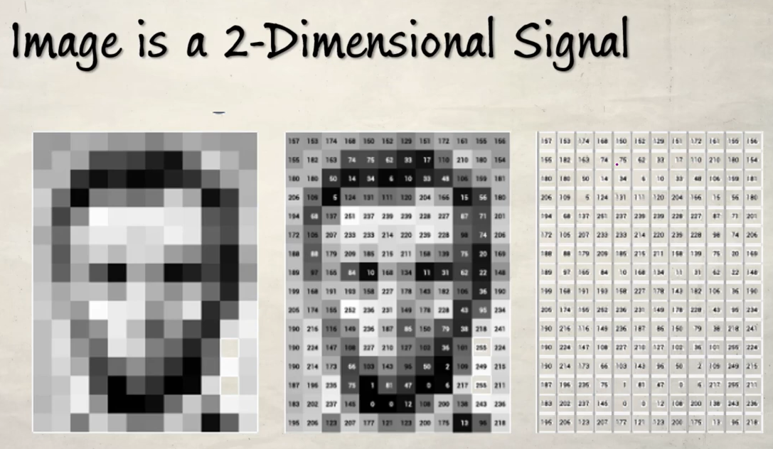

Slide 19
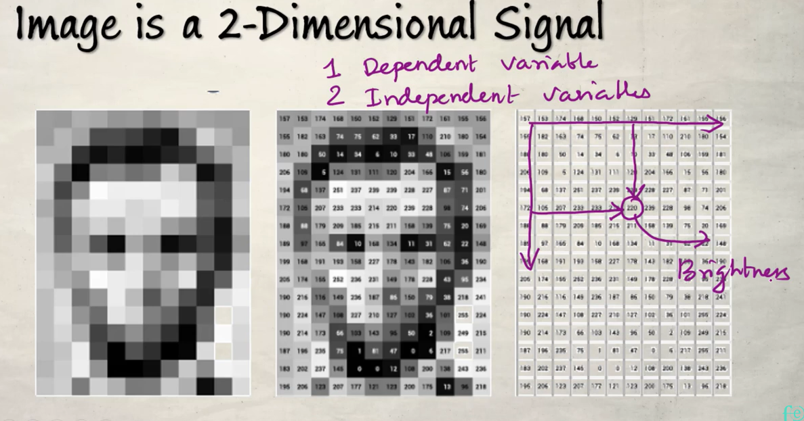

Slide 20
